Slide 1
“I’d Rather Be”
13 June 2018

Slide 2
“I’d Rather Be”
Challenges | Communication | Collaboration
https://www.youtube.com/watch?v=QDh9Oz6EXqY

Slide 3
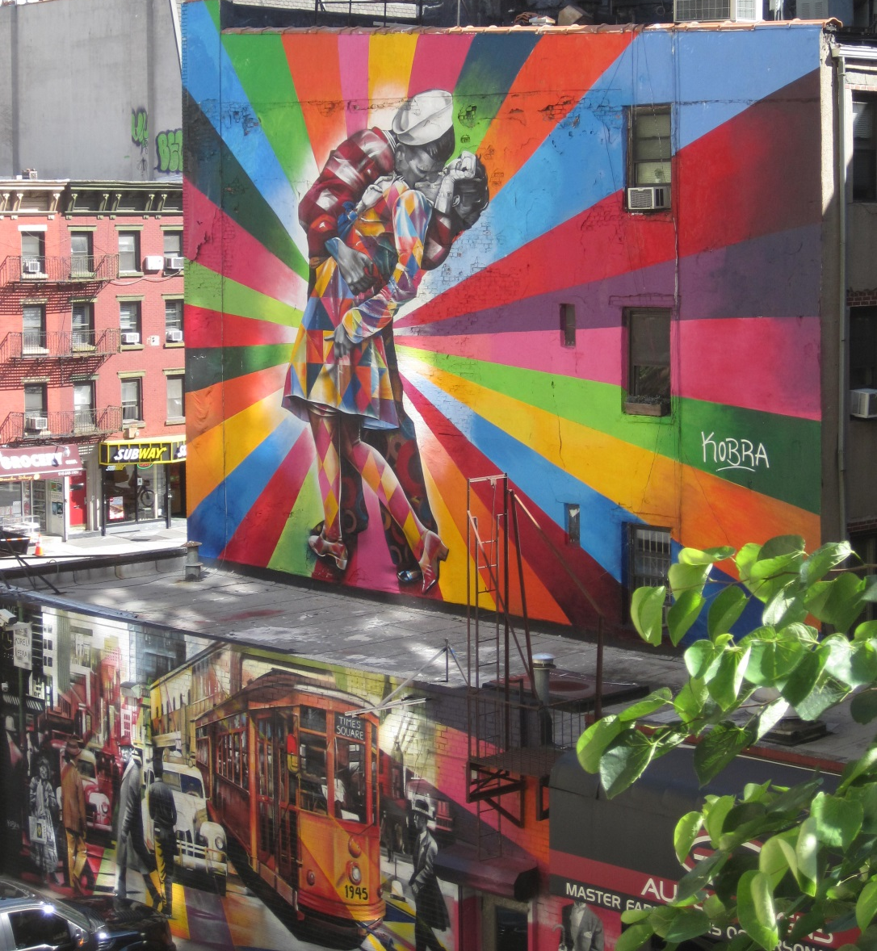
“Those Horrible Application Forms”
Judicial and Silk
Appointments Workshops
2018
https://asktim.org/2017/01/workshops/

Slide 4
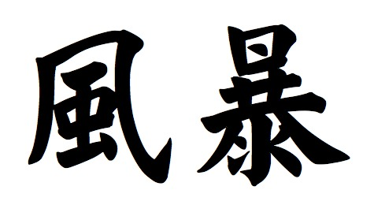
Ancient Chinese Proverb
I hear, I forget.
I see, I remember.
I do, I understand.
https://www.youtube.com/watch?v=ooLoBPsjFgw&feature=em-subs_digest

Slide 5
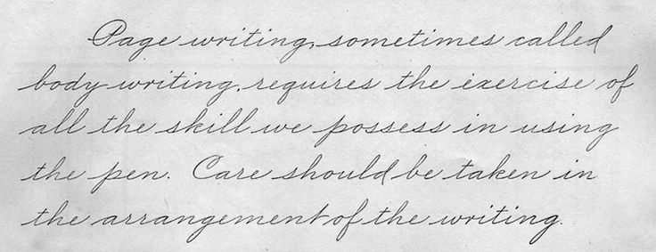
https://asktim.org/2017/06/an-amazing-woman/

Slide 6
http://asktim.org/2016/06/steps/

Slide 7
Favourite Quotes?
“We cannot solve problems by using the same kind of thinking that created them”
“Insanity: Doing the same thing repeatedly and yet expecting a different result”

Slide 8
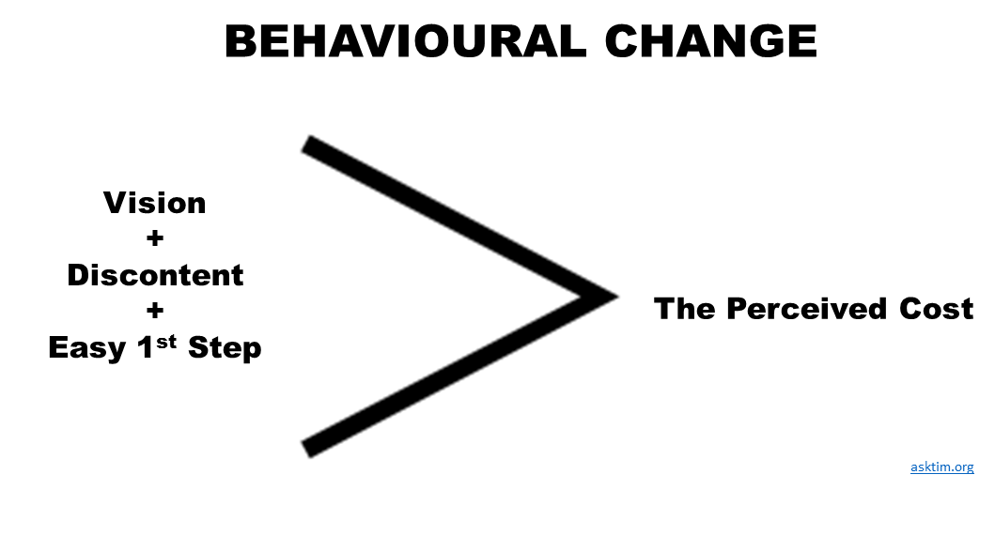

Slide 9
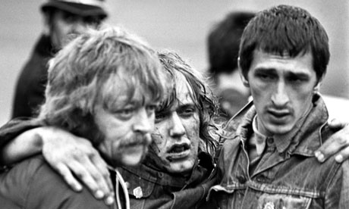
Transparency & Would Your Mum be Proud of You?
http://asktim.org/2013/11/radical-business/

Slide 10
Power
http://asktim.org/2013/10/a-bottle-of-orange-squash-balancing-the-books/

Slide 11
Failure

Slide 12
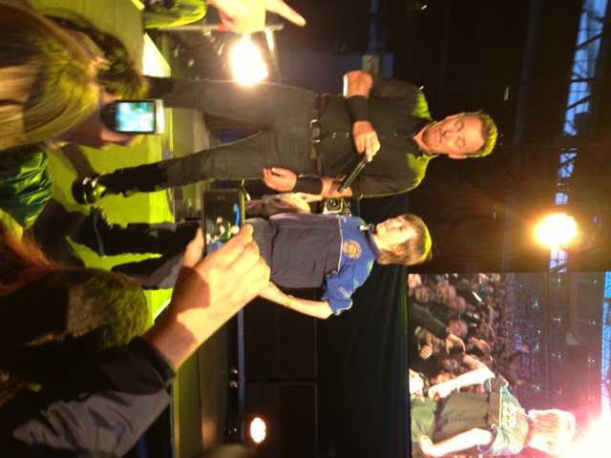
If You Knew You Couldn’t Sing - Would You Sing In Front of 71,000?
http://asktim.org/2013/09/sing-to-71000/

Slide 13
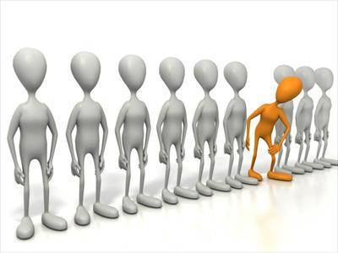
How do we know we’ve got it right?
https://www.youtube.com/watch?v=qA-gbpt7Ts8

Slide 14
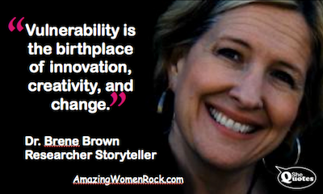
http://www.ted.com/talks/brene_brown_on_vulnerability?language=en

Slide 16
https://www.fastcompany.com/3063262/lessons-learned/what-happened-when-i-moved-my-company-to-a-5-hour-workday

Slide 17
Why you hate work - New York Times 2014
White Collar Salt Mine Survey
Mid-sized Accountancy Firm Pilot
http://www.nytimes.com/2014/06/01/opinion/sunday/why-you-hate-work.html?_r=0

Slide 18
“Send Three and Four Pence We’re Going to a Dance”

Slide 19
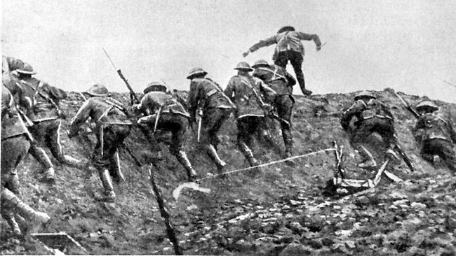
http://quoteinvestigator.com/2011/08/26/reinforcements/

Slide 20
Real Communication
“Communication is not about what you intend to communicate but more importantly what people are willing, able and likely to pick up”

Slide 21
http://asktim.org/2015/06/ting/

Slide 22
Appealing to an Audience
Intellectual Content
Stylistic/Technical
Emotion

Slide 23
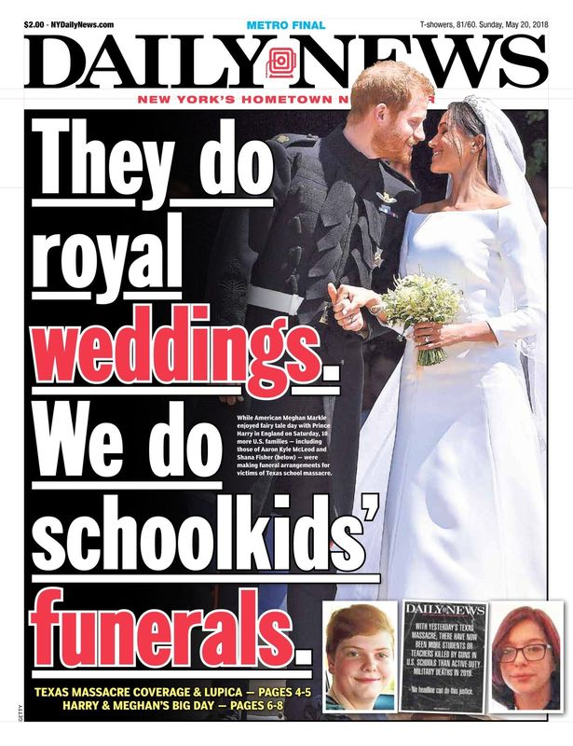

Slide 24
“There were 5 Exabytes of information created between the dawn of civilization through 2003, but that much information is now created every 2 days.”
Eric Schmidt Google CEO 2010
https://blog.rjmetrics.com/2011/02/07/eric-schmidts-5-exabytes-quote-is-a-load-of-crap/

Slide 25
tl;dr

Slide 26
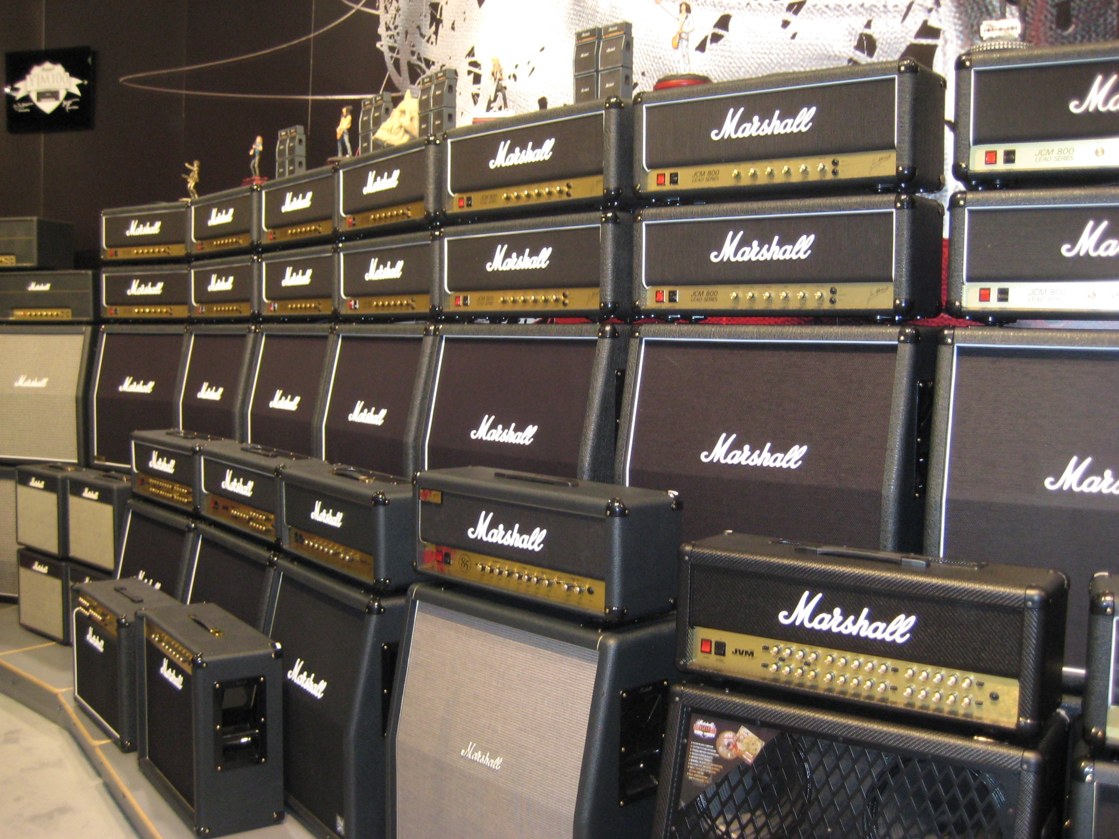
aAMPLIFICATION
https://crimeline.co.uk

Slide 27
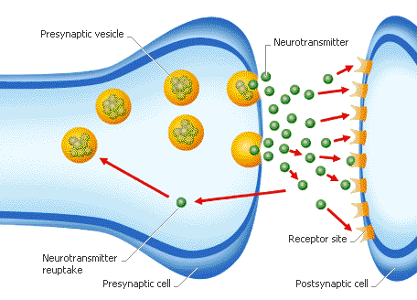
Threshold & Repetition

Slide 28
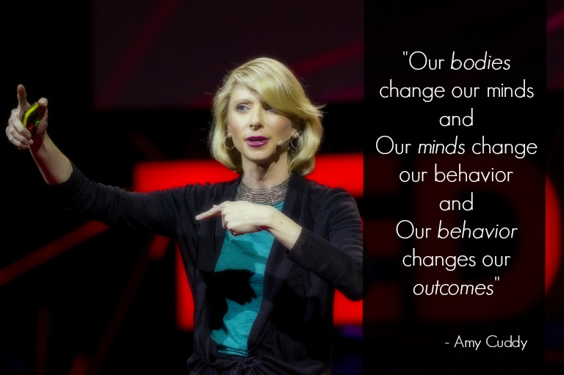
https://www.youtube.com/watch?v=Ks-_Mh1QhMc
http://www.bbc.co.uk/news/uk-politics-43960452

Slide 29
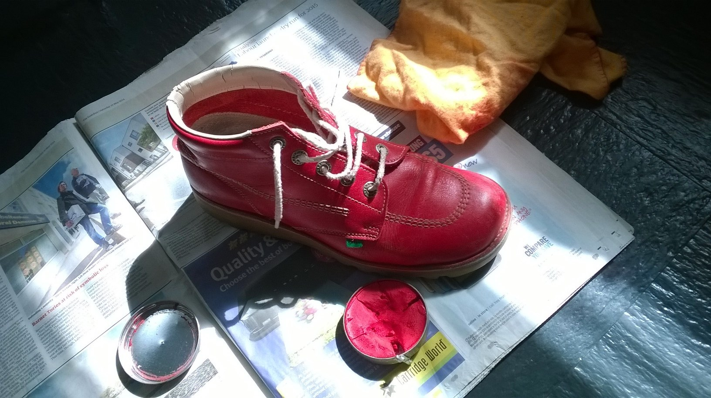
http://asktim.org/2014/02/kickers/

Slide 30
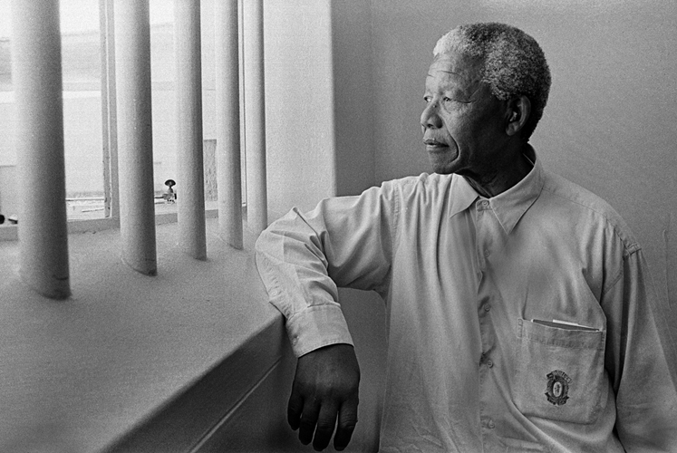
Powerful Words
Please
Sorry http://asktim.org/2014/05/sorry/
Thank You

Slide 31
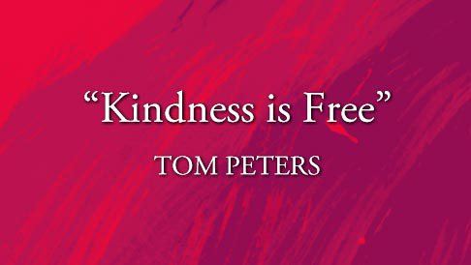
https://www.youtube.com/watch?v=YIvZSAEnAuc&feature=youtu.be

Slide 32
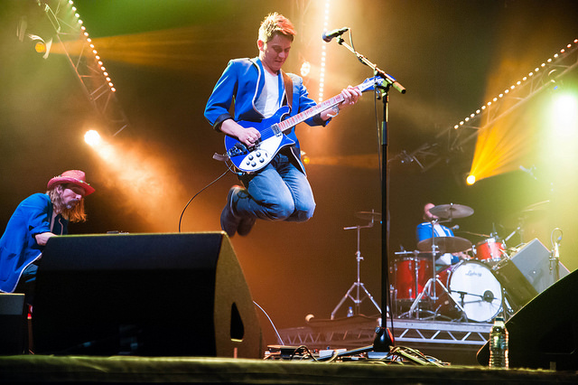
Smart Collaboration
http://asktim.org/2014/12/collaboration/

Slide 33
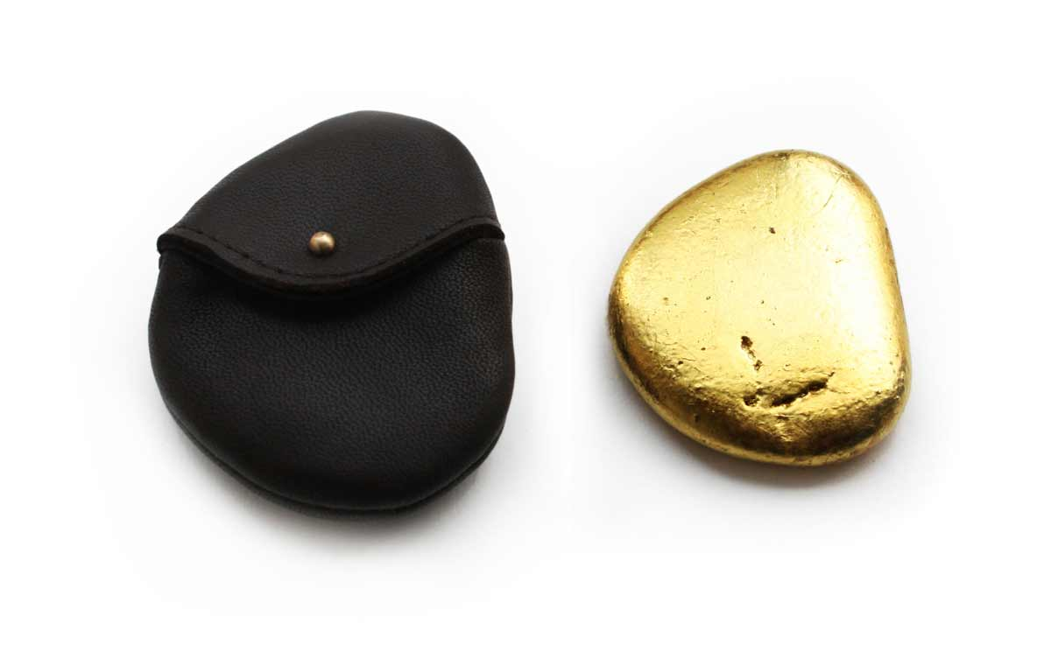
Creative Thinking
http://asktim.org/2014/02/halifax/

Slide 34
Single Feedback Loop

Slide 35
Double Feedback Loop

Slide 36
Triple Feedback Loop
HOW?
WHAT?
WHY?

Slide 37
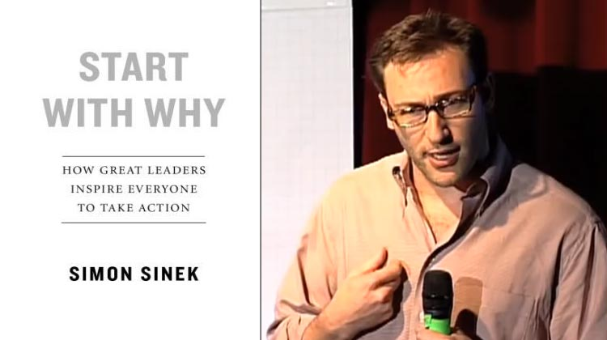
http://www.ted.com/talks/simon_sinek_how_great_leaders_inspire_action.html

Slide 38
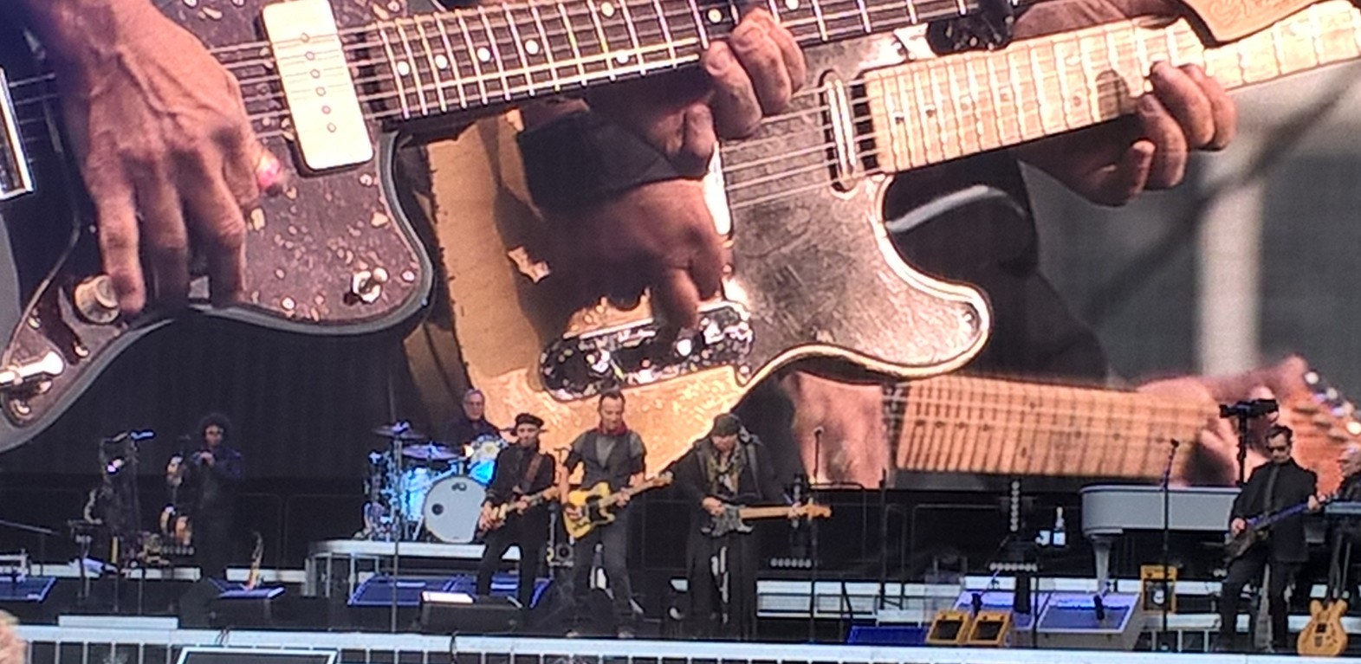
https://www.linkedin.com/pulse/lessons-from-boss-tim-collins?trk=pulse_spock-articles

Slide 39
Appreciative Inquiry
https://www.youtube.com/watch?v=ZwGNZ63hj5k

Slide 40
Engagement
An "engaged employee" is one who is fully absorbed by and enthusiastic about their work and so takes positive action to further the organisation's reputation and interests.
Jeremy Scrivens: http://emotionaleconomy.com.au/ Dr George Madine: http://drgeorgemadine.co.uk/

Slide 41
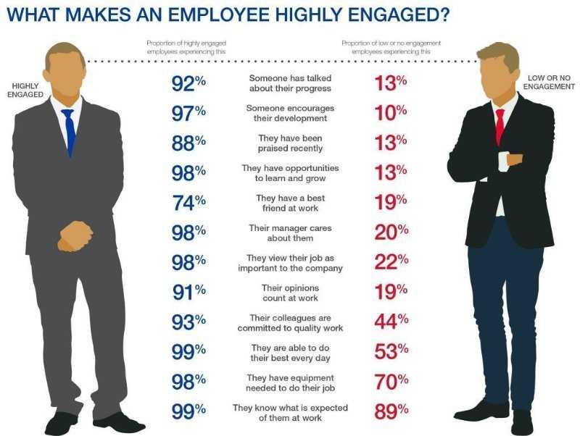
NB Sorry about the two blokes in suits!

Slide 42
The four enablers of engagement
MacLeod 2009 Engaging For Success report to government
http://www.engageforsuccess.org/
Visible, empowering leadership providing a strong strategic narrative about the organisation, where it’s come from and where it’s going.
Engaging managers who focus their people and give them scope, treat their people as individuals and coach and stretch their people.
There is employee voice throughout the organisations, for reinforcing and challenging views, between functions and externally, employees are seen as central to the solution.
There is organisational integrity – the values on the wall are reflected in day to day behaviours. There is no ‘say –do’ gap.

Slide 43
Most Organisations:
Command & Targets

Slide 44
Most Organisations:
Command & Targets
21st Century We Need:
Trust & Coaching

Slide 45
How Can We Build Trust?
http://asktim.org/pay-fair/
http://asktim.org/2015/02/pay-me-my-money-down/

Slide 46
https://unbound.com/books/grenfell/

Slide 47
Thank You
T: 0796 999 7335
E: tim@asktimc.org
@wowthankyoutim

